Slide 1


Department of Computer Science, CUI Lahore Campus
Formal Methods in Software Engineering
By
Farooq Ahmad

Slide 2
Functions in Z
Functions data type, function variables, partial functions

Slide 3
Topics covered in the lecture
Function data type
Function variable
Partial and total function
Lambda notation

Slide 4
What is a function
Sometimes we need to associate a single item with each element in a set. For this we use a special kind of relation, called a function.
A function is a binary relation where an element can appear only once as the first element in a pair.
A function between two sets X and Y is a relation between those sets that has a special property, namely that each member of the from-set is related to at most one member of the to-set.

Slide 5
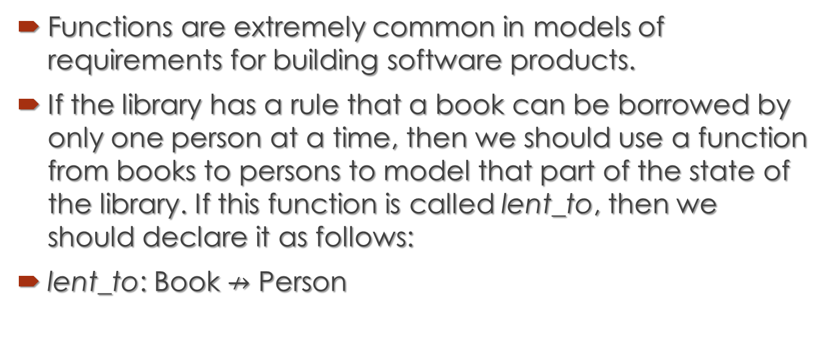
Functions in formal specification
Functions are extremely common in models of requirements for building software products.
If the library has a rule that a book can be borrowed by only one person at a time, then we should use a function from books to persons to model that part of the state of the library. If this function is called lent_to, then we should declare it as follows:
lent_to: Book $↛$ Person

Slide 6
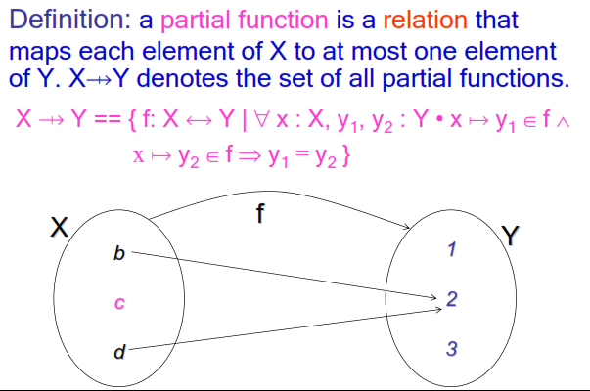
Definition: partial function
A term partial function is sometimes used to describe what is here called a function.

Slide 7
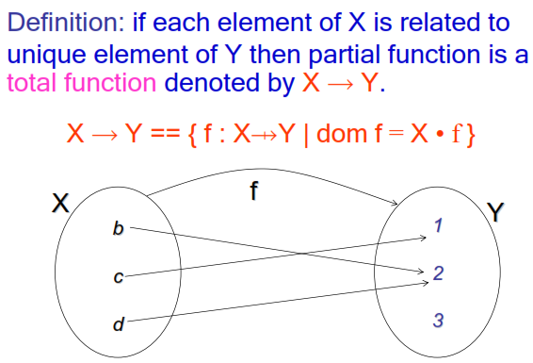
Total function

Slide 8
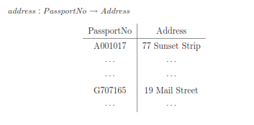
Example: address

Slide 9
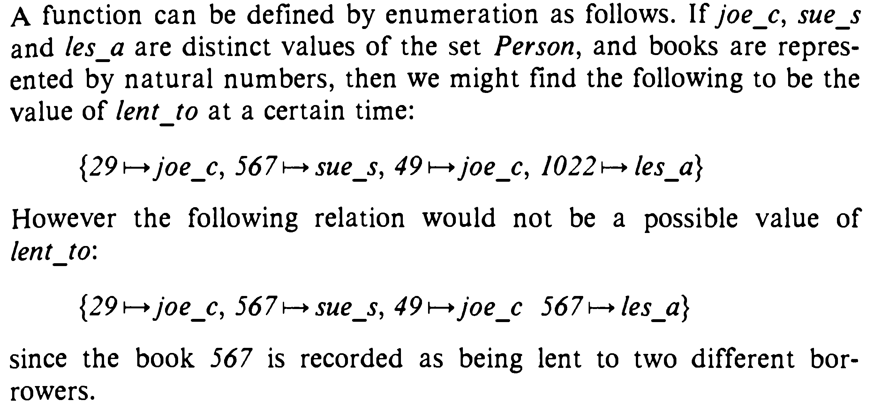
Function by enumeration

Slide 10
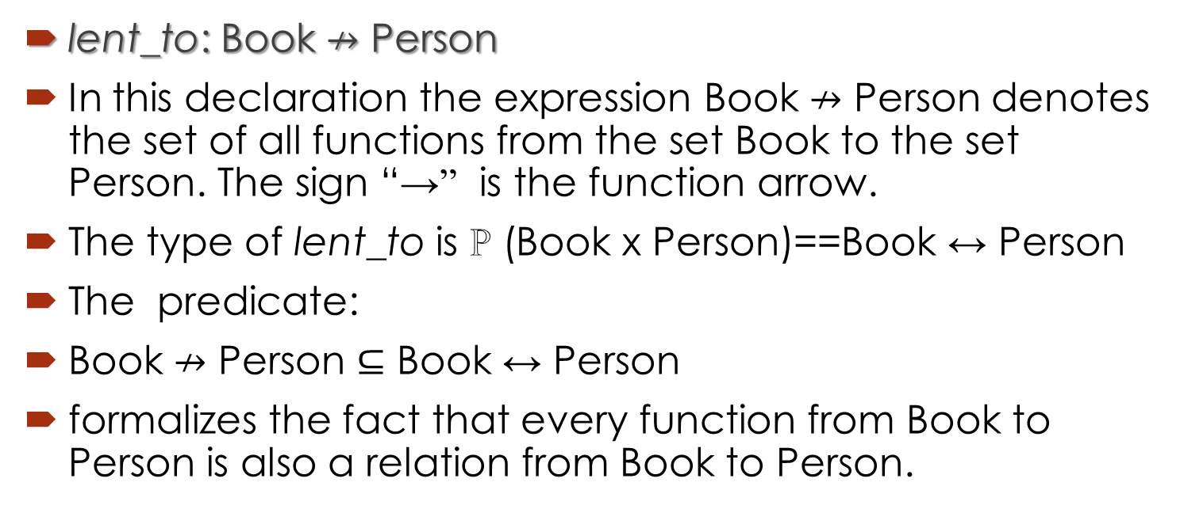
Function data type: set of all functions
lent_to: Book $↛$ Person
In this declaration the expression Book $↛$ Person denotes the set of all functions from the set Book to the set Person. The sign “→” is the function arrow.
The type of lent_to is ℙ (Book x Person)==Book ↔ Person
The predicate:
Book $↛$ Person $⊆$ Book ↔ Person
formalizes the fact that every function from Book to Person is also a relation from Book to Person.

Slide 11
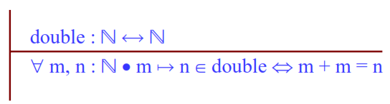

Example: Total function
We may define a relation “double” on the set of natural numbers as: This relation is a total function because for every natural number m there is a unique number n such that m $↦$ n ∈ double.

Slide 12
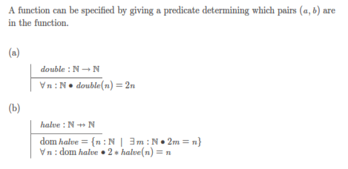
Example: half as a Partial function

Slide 13
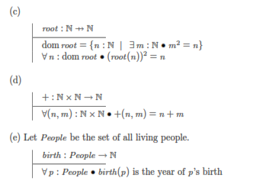
Examples of functions

Slide 14
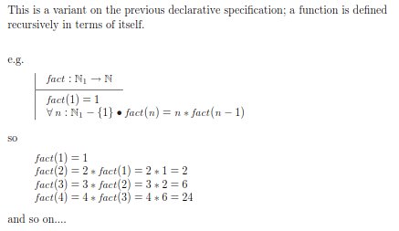
Recursive function

Slide 15
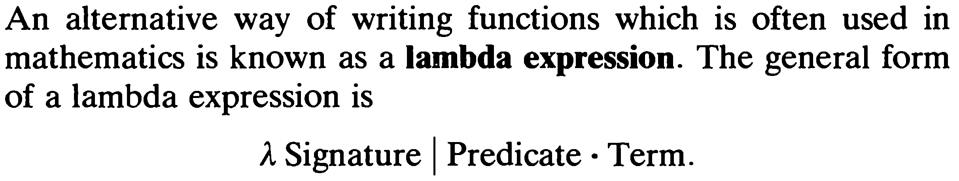
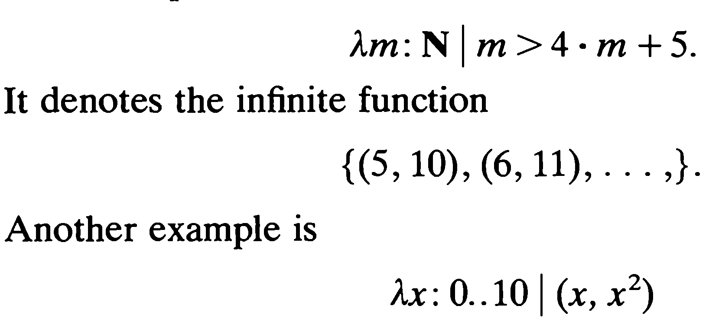

Lambda notation for functions

Slide 16
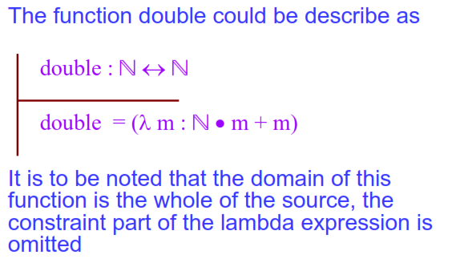
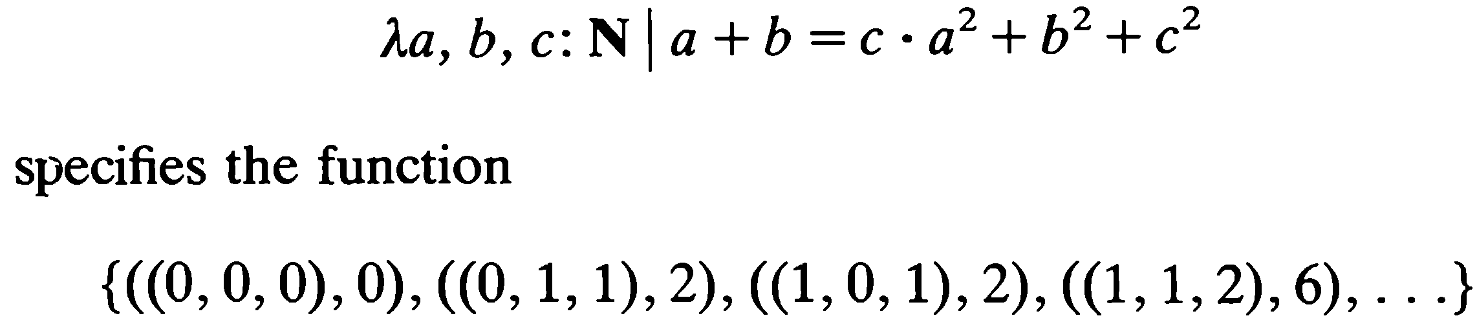

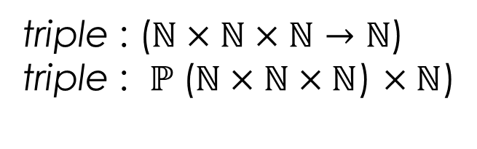
Examples of Lambda notation
$$λD|P ● E$$
triple : ($ℕ×ℕ×ℕ→ℕ$)
triple : $ℙ$($ℕ×ℕ×ℕ$) $×ℕ$)

Slide 17
Summary of the lecture: conclusion
Definition of a function
Partial and total function
Function data type
Declaring function variables
Lambda notation for representing functions

